Slide 1

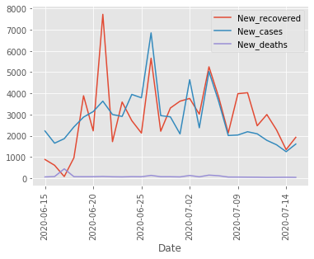
DELHI DETAIL OVERVIEW OF COVID 19
BY-PRIYANSH YADAV

Slide 2

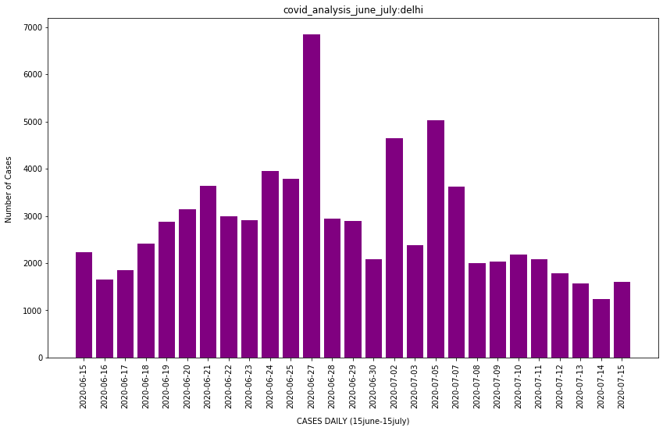
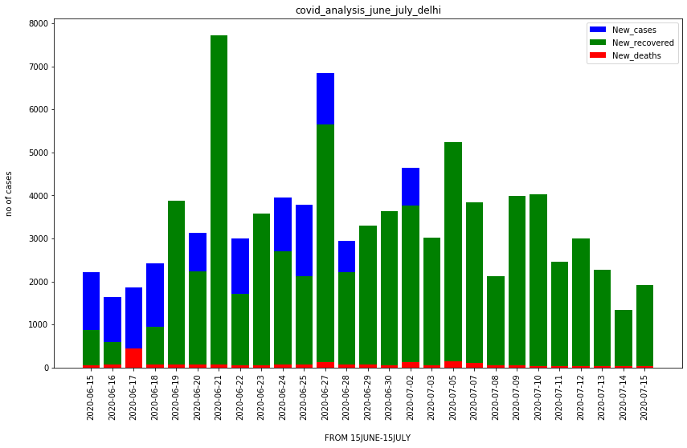
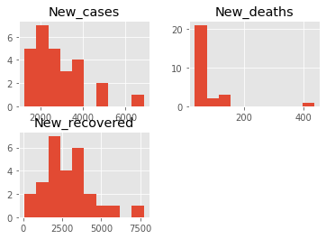
DELHI COVID-19 DASHBOARD for Honourable Chief Minister
New cases

Slide 3

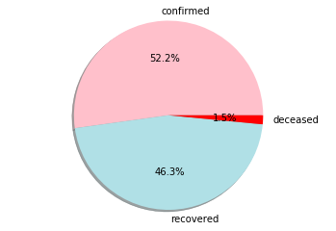
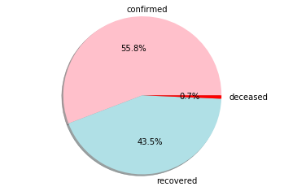
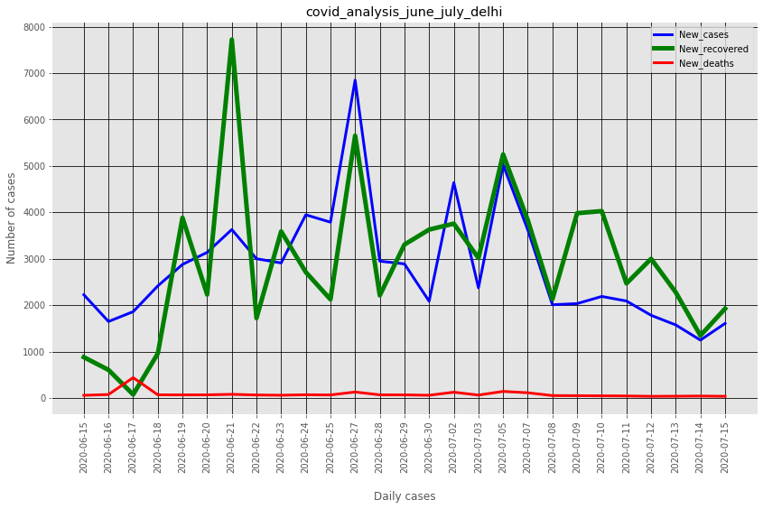
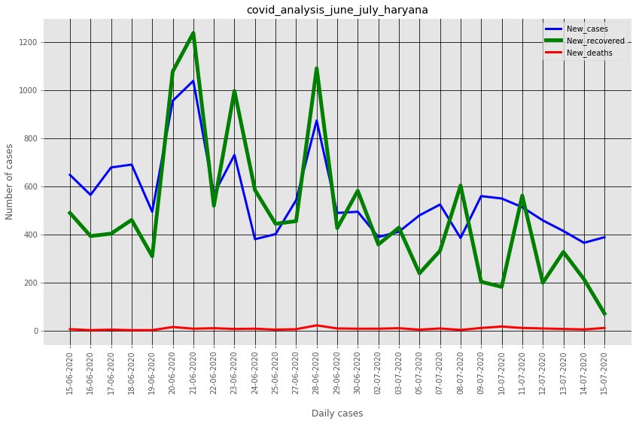
DELHI COMPARITION WITH HARYANA
DELHI
HARYANA

